Slide 1
Qlik GeoAnalytics

Slide 2



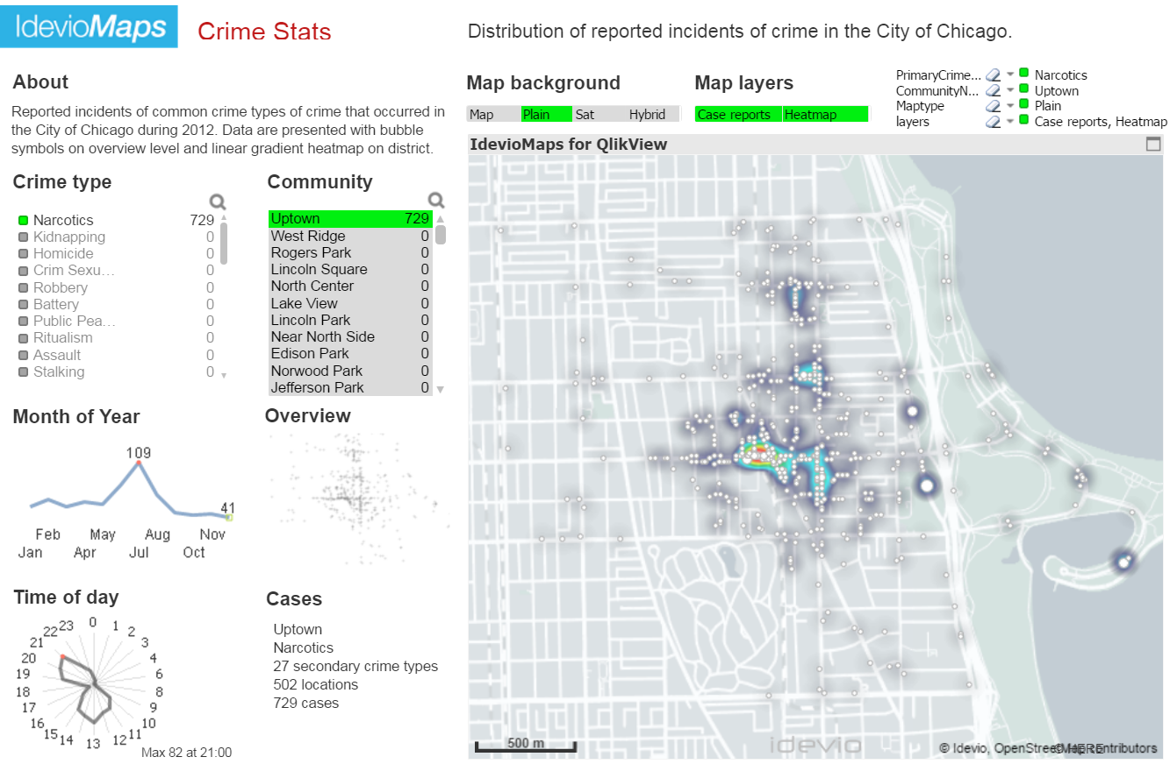
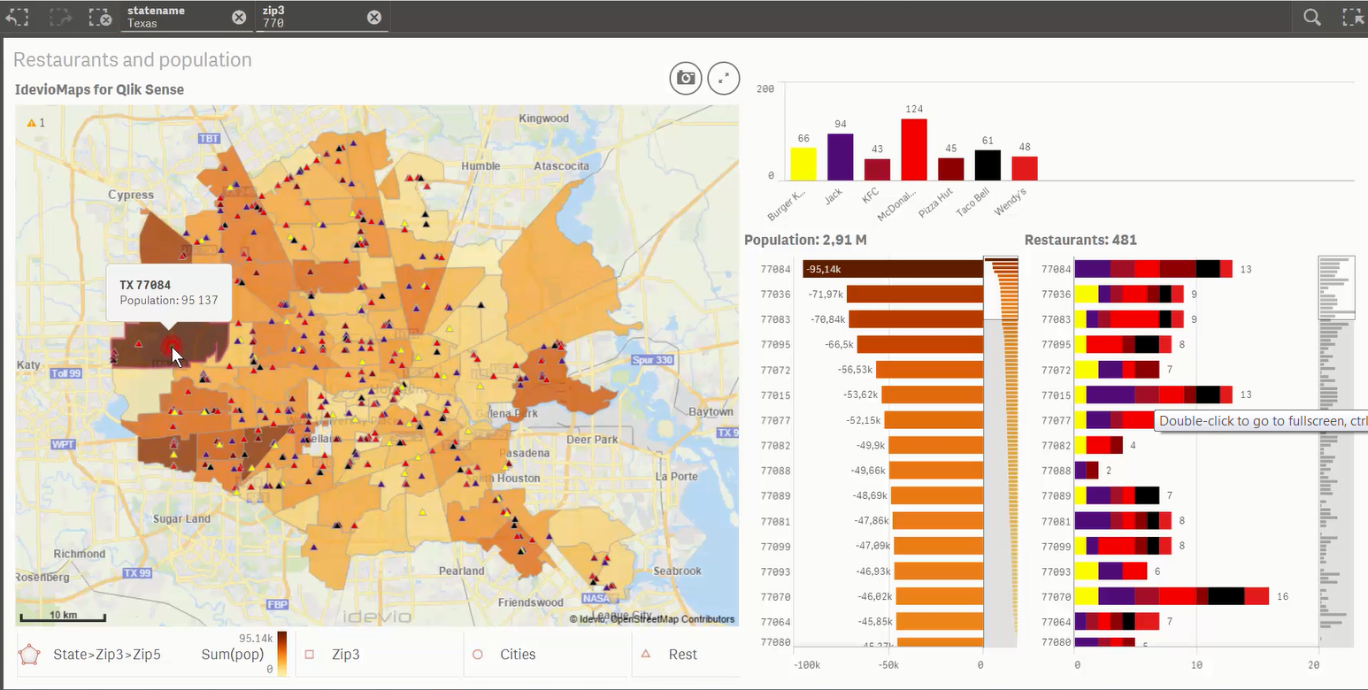
Powerful map visualization and location-based analytics for both Qlik Sense and QlikView
High performance, interactive mapping
Gain insight into geospatial data
Increase ROI with location-related use cases
Notes:
Make better location-related decisions.
Ex. Site selection, resource allocations, or delivery times
Improve understanding
Gain insight into patterns not easily interpreted through tables or charts
Map paradigm is a familiar environment to most users.
Increase productivity
Enable any Qlik user to easily add rich, interactive geo visualizations to their Qlik apps.

Slide 3



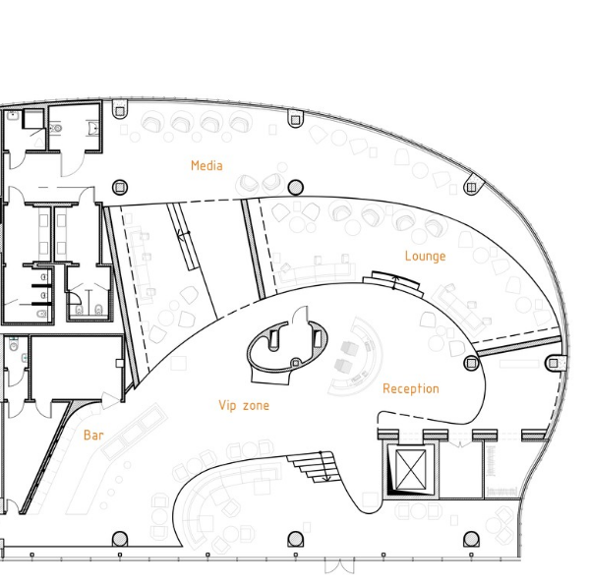


High performance, interactive mapping
Improved Information Density in Geospatial Visualizations
Multiple Layer Support in Geospatial Visualizations
Lines and Arcs for flows of goods, products, or money
Drill-down from Regions to Sub-regions in Maps
Animation control for time series and events
Indoor Mapping floorplans of airports, shopping malls.

Slide 4






Gain insight into geospatial data
Geometric operations - Within, Intersects, Dissolve
Aggregating operations - Binning, Cluster, Spatial index
Route operations -TravelAreas, Closest, Spatial Index
Lookup operations -Places, Addresses, Coordinates and IP addresses.
Connectivity operations - geodata from flat files, databases and web services.
Street Level Geocoding (Consumption Based Licensing)

Slide 5
Qlik GeoAnalytics Connector Operations
http://bi.idevio.com/geoanalytics/features

Slide 6
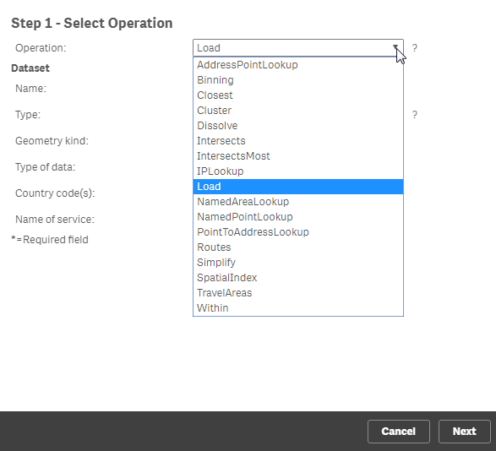
Qlik GeoAnalytics Connector Operations
Operation | Summary
Address Point Lookup | Returns point geometries for each address in a table
Binning | Generates rectangular or hexagonal bins for a point dataset. Generates a table with the bin geometries with a field that is an association to the original dataset.
Closest | Returns relations and distances between objects in one dataset and the closest n objects in another, if any is closer than the maximum distance.
Cluster | Produces clusters from a point dataset. Returns a table with relations between points and clusters.

Slide 7
Qlik GeoAnalytics Connector Operations
Operation | Summary
Dissolve | Dissolves and simplifies areas to form larger areas based on a mapping between old area identities (or geometries) and new area identities. This is typically used for building custom areas that are build up by smaller well defined areas.
Intersects | Returns a table that maps between the key in dataset1 and the key in dataset2 for all objects that intersects.
Intersects Most | Same as Intersects but only returns the relation to the area in Dataset2 each area in Dataset1 overlaps the most. This operation is useful when you want to build a hierarchy and relate smaller areas to larger areas but the smaller areas might overlap some borders of the larger ones.

Slide 8
Qlik GeoAnalytics Connector Operations
Operation | Summary
IP Lookup | Returns location information and point geometries for IP-addresses in a table. This is useful when you are analyzing access data to web services.
Load | Just loads the dataset, no operation applied. This makes it possible to load all the formats that GeoAnalytics supports.
Named Area Lookup | Returns area geometries for each name in a table by looking them up in the location service. In the location service names for things like countries, administrative areas, airports, postal codes etc are available.

Slide 9
Qlik GeoAnalytics Connector Operations
Operation | Summary
Named Point Lookup | Returns point geometries for each name in a table by looking them up in the location service. In the location service names for things like countries, administrative areas, airports, postal codes etc are available.
Point to address Lookup | Returns closest address for each point in the list
Routes | Calculates routes including length and duration, between two locations in a table. Returns a table with key, length (in meters), duration (in seconds), status (ok or no route found) and a low resolution route line.

Slide 10
Qlik GeoAnalytics Connector Operations
Operation | Summary
Simplifiy | Simplifies the line and area geometries in the dataset. The degree of simplification is calculated automatically based on area, number of objects and size of objects. It is then possible to adjust that to a higher or lower resolution with the Resolution parameter. Area simplification is done with an advanced algorithm that handles topologies and can remove gaps and join islands
SpatialIndex | Generates a spatial index for a dataset that is needed for the "Select Visible" feature in IdevioMaps.
Travel Areas | Calculates travel time into areas. All locations within the returned area can be reached within a certain time or is closer than a certain distance along roads. If you use "bird" as transportation type it generates geographically correct circles around the origins.

Slide 11
Qlik GeoAnalytics Connector Operations
Operation | Summary
Within | There is a relation between enclosed and enclosing if enclosed is completely inside the enclosing area

Slide 12
Qlik GeoAnalytics Connector Datasets

Slide 13

Qlik GeoAnalytics Connector Datasets
Data sources that can be used with operations in Qlik GeoAnalytics.
Database
Access to files in a Database
File Based Geo Dataset
Different kinds of geographical file formats like GeoJSON and Shape
Loaded Table
Data that is already loaded from other sources may be used as as a dataset
Separated Text File
Text files with table data, optionally with geometries. Instead of geometries also names of locations may be specified.
Standard Areas & Points
Points and areas that are available in the Qlik GeoAnalytics location service.

Slide 14
Setting up the following Operations:
Routes
Closest
Dissolve
Travel Areas
Binning
Cluster
Loading a Shape File
Within

Slide 15
Qlik GeoAnalytics
Setting up the Operations
Routes

Slide 16
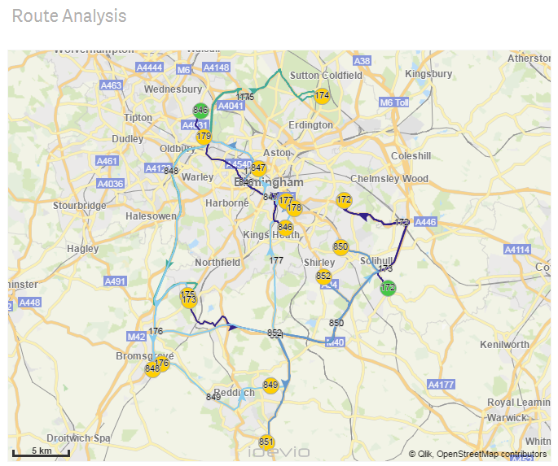
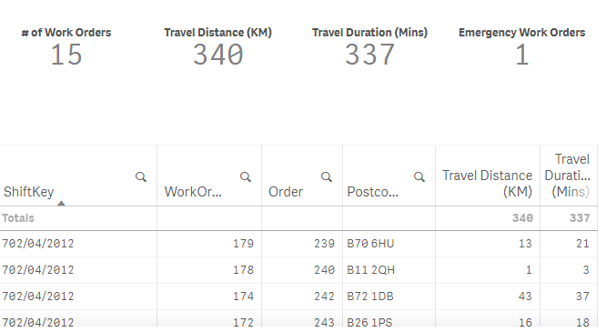
Routes – Use Cases
How far are our employees travelling, and how long is it taking?
How many stops are they making on a route?
If I had to get from A to B, what is the quickest or shortest route?
This is NOT route optimisation, it is route analysis .. What happened based on GIS data.
It can be based on Car, Pedestrian, Bird, Bike or Truck.

Slide 17
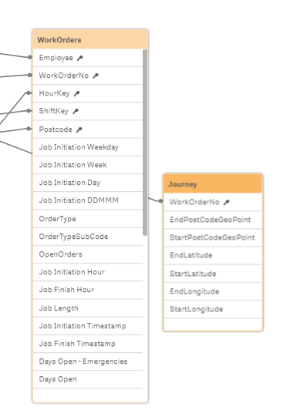
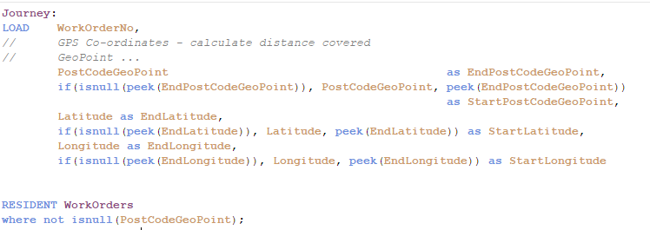
Routes – The data
I have one main table, WorkOrders which has a ShiftKey field (which is all jobs in a day by engineer) and WorkOrderNo field, which is the individual jobs and based on the PostCode I have brought in the Lat / Long per WorkOrder and also a GeoMakePoint for the Lat/Long of the locations.
I then loaded this data into a new table – ‘Journey’ – and used the following code to create a start and end for each job, i.e. starting at one job and then ending at the next job.

Slide 18
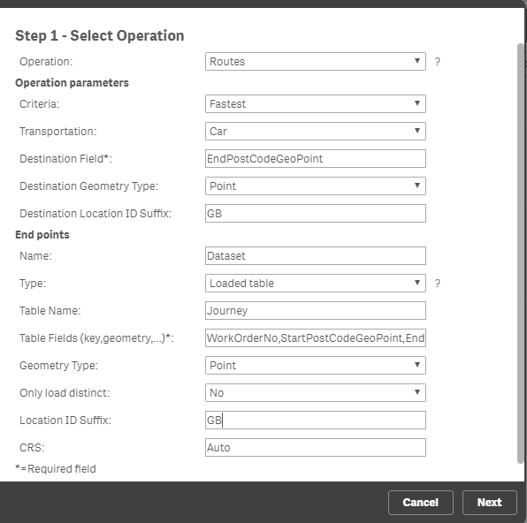
Routes – The Connector
Destination Field: I am using the field ‘EndPostcodeGeoPoint’, which has been created using the Qlik makeGeoPoint (lat,Long). This is the end of the GeoPoint for my journey or route.
Destination Geometry Type: It is a Point – if I had the lat / long separated in the destination field, then this would be a ‘Latitude, Longitude Point’
I’m using the ‘Loaded Table’ Type, therefore the wizard defaults and I need to enclosed my table ‘Journey’ and the main Table Fields: These are my key in my loaded table, ‘WorkOrderNo’ and the start and end points (still using a Geometry type of ‘Point’ ‘StartPostCodeGeoPoint’ and ‘EndPostCodeGeoPoint’.
I have also used the Location ID suffix for both as ‘GB’ although that wasn’t really required as it is only UK data.

Slide 19
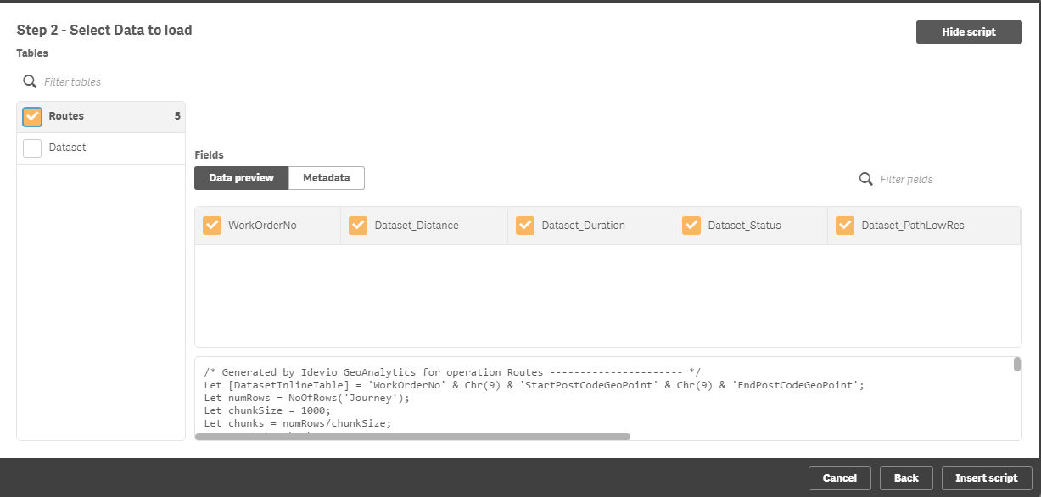
Routes – The Connector
Click on next, as the operation has not yet run, the table will be blank. I only need to select the new ‘Routes’ as the second table ‘Dataset’ refers to the key fields from the table I have already loaded.
Click on Insert Script, and Qlik GeoAnalytics will create the script that is required.

Slide 20
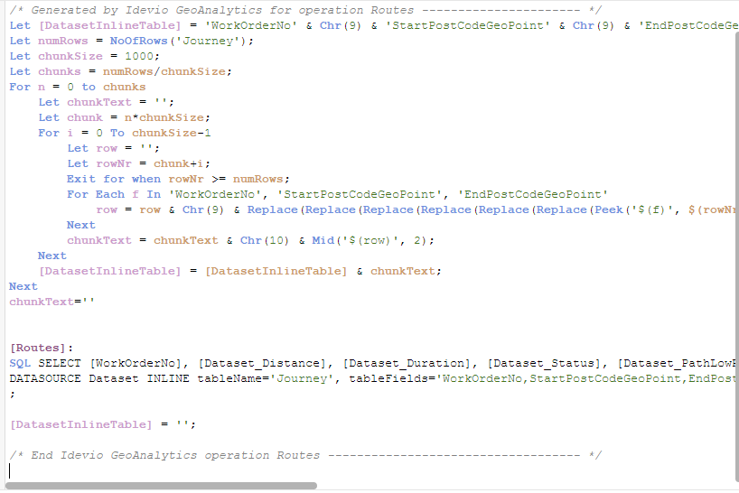
Routes – The Connector
Potential Errors:
The most likely error is going to be caused by either the a end or the b end of a route not having a value you in it – therefore you need to ensure that both have values (GeoLocationPoint), or remove any routes that don’t.
The Baseline version of GeoAnalytics Connector allows for 100 Routes, GeoAnalyticsPlus is for 400 Routes. Over that Qlik GeoAnalytics Enterprise is required.

Slide 21
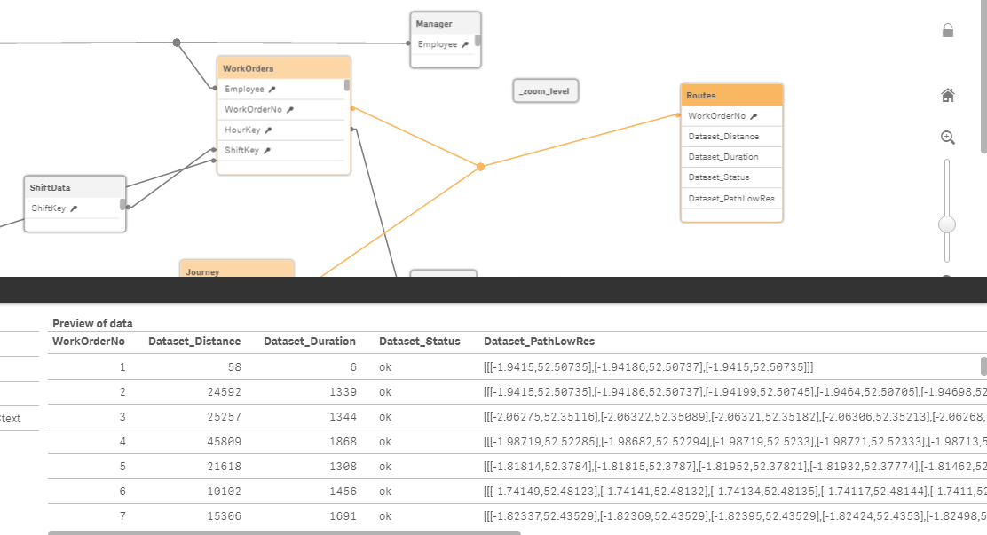
Routes – The Connector
A new table has been created by the Qlik GeoAnalytics Connector, this is my ‘Routes’ table and has the driving line (for my example in a car and fastest time) from Start to Finish. It also has the distance (km?) and time of travel.

Slide 22
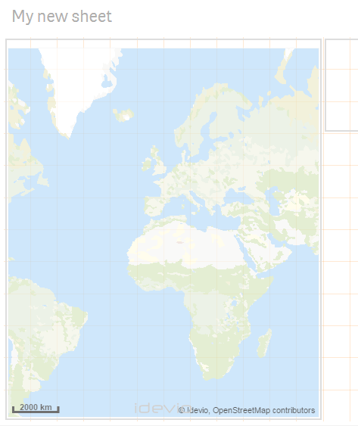
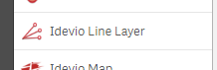
Routes – Showing the info on a map
Create a new map, or use an existing one – to represent Routes, you will need to use the Line Layer.

Slide 23
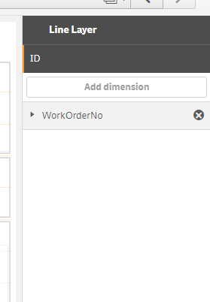
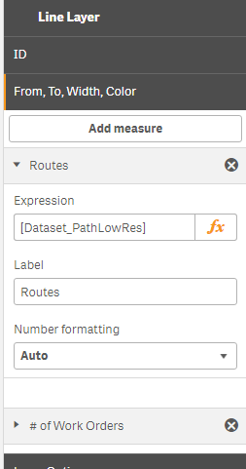
Routes – Showing the info on a map
The ID is your individual route (in this case WorkOrderNo)
The measure is the new field that was created by the Qlik GeoAnalytics Connector’s route operation, in my case ‘Dataset_PathLowRes’.

Slide 24
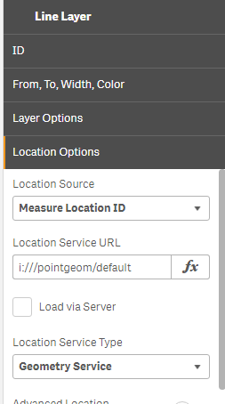
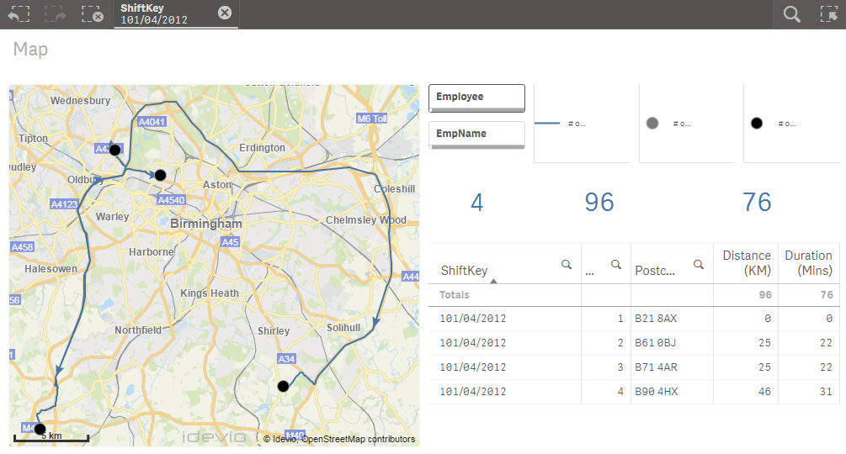
Routes – Showing the info on a map
Ensure that the Location service is ‘Measure Location ID’ as we are using a ‘GeoPoint’, if we were using Latitude and Longitudes instead this could be changed.
.. And my drive lines should appear on the map, if they don’t, try shutting down the app and re-opening it. In my example I have also shown the start and end points (if you select a WorkOrderNo, these will be clearer), and the distance and duration and the direction of the arrows.

Slide 25
Qlik GeoAnalytics
Setting up the Operations
Closest

Slide 26
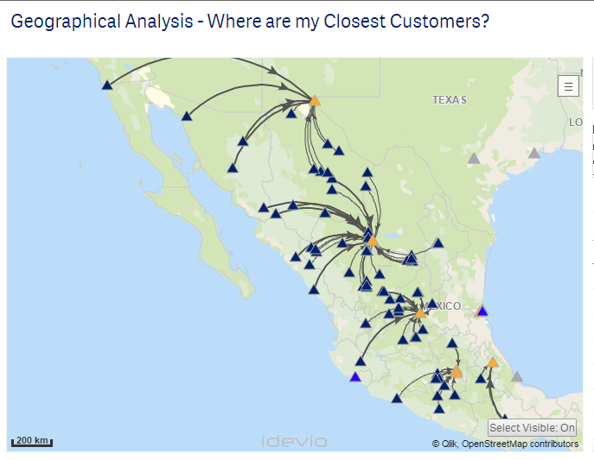
Closest - Use Cases
Where is my closest?
How far do my patients travel to get to a Hospital
Where are my closest Sales people to customers?
Where is my closest retail unit?
For a demographic, where is the closest point for people to go to from a location?
Am I sending the right consultant to see a customer based on where they live?

Slide 27
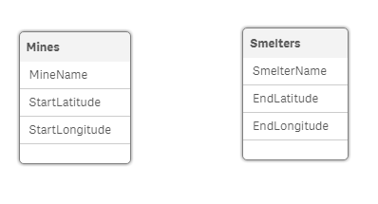
Closest – The Data
I have two separate tables loaded that currently have no associations. They have a name and a location (using Latitude and Longitude).

Slide 28
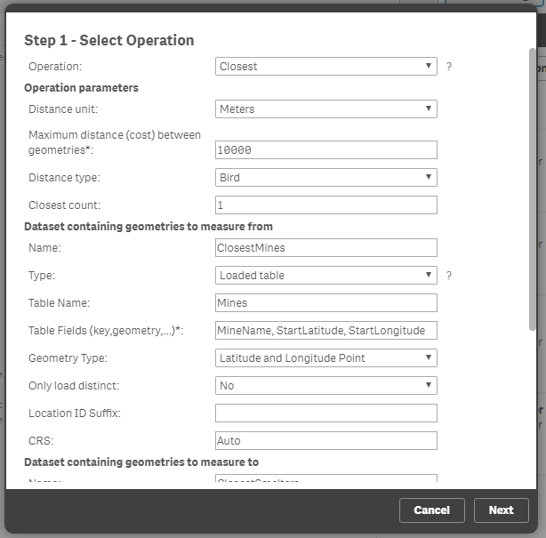
Closest – The Connector
For the parameters I want to see the closest (or links between the two, where its within 100km, and I don’t need the drive routes, so I’m just doing it based on a bird ..
As the data is already loaded into memory, I create my first table to store the dataset (Closest Mines), and link back to my created table ‘Mine’ and the relevant fields, MineName (key), and StartLatitude and StartLongitude (which are my geometry fields.
As these are lat / long – I choose the ‘latitude and longitude point as the type.

Slide 29
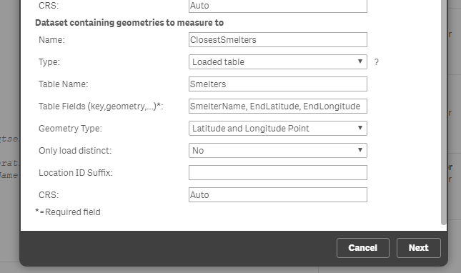
Closest – The Connector
The second data set is my smelter information. Again I use the loaded table – ‘Smelter’s and the key field and geometry points.

Slide 30
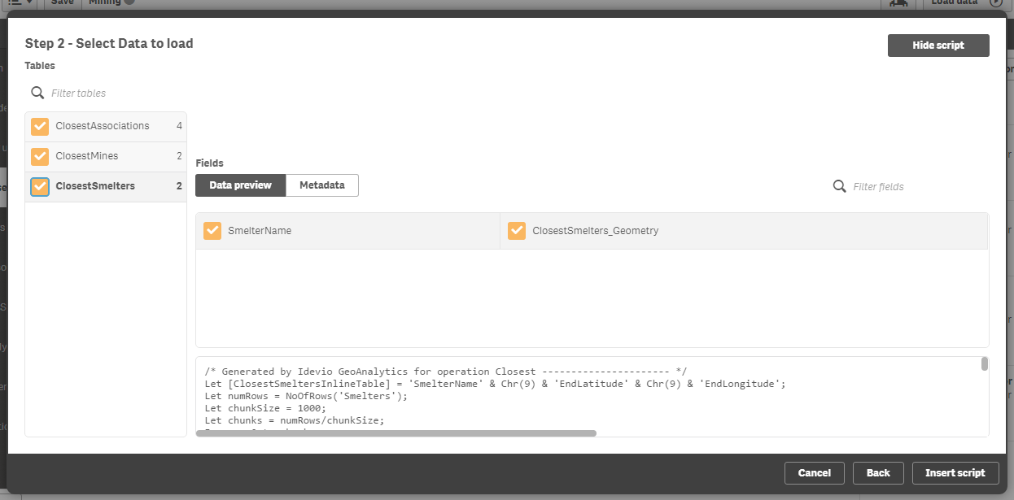
Closest – The Connector
I’m choosing to load all three tables as the geometries are created in the second two, and the associations in the first.

Slide 31
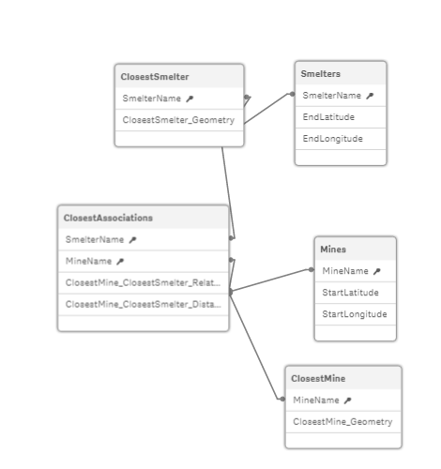
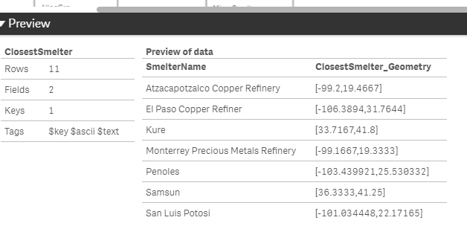
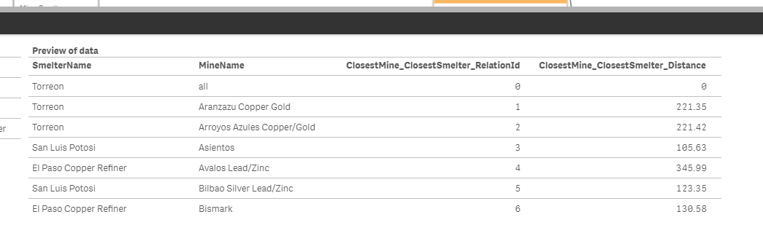
Closest – The Connector
Three new tables are created..
The geometry for each of my loaded table and the relationship of which one is the closest.

Slide 32
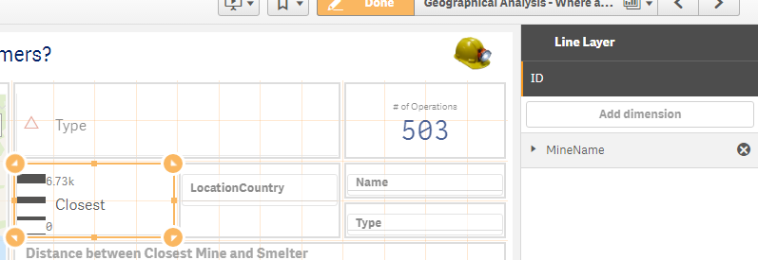
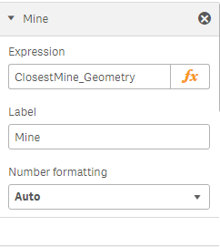
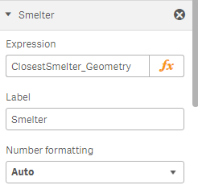
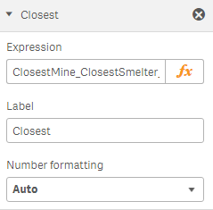
Closest – Showing the info on a Map
To visualise the new data, I use a line layer. The dimension I’m using is the Mine, or customer.
The first expressions is the new geometry field for the first loaded table.
The Second is the second loaded table new geometry field.
The third is the newly created relationship between the tables.

Slide 33
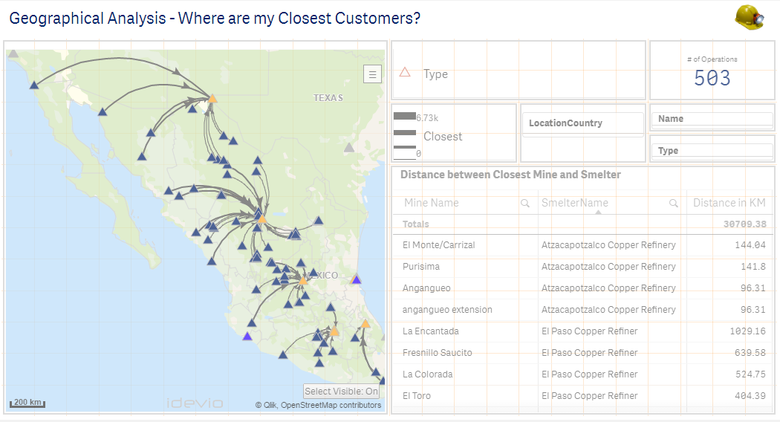
Closest – Showing the info on a Map
I have also used a point to show the location of both the Mines and Smelters, this should have been two separate bubble objects, but I already had this data in a different table that held both Mines and Smelters – I seprated them out into a data island to run the ‘Closest’ operation, although that is not required.

Slide 34
Qlik GeoAnalytics
Setting up the Operations
Dissolve

Slide 35
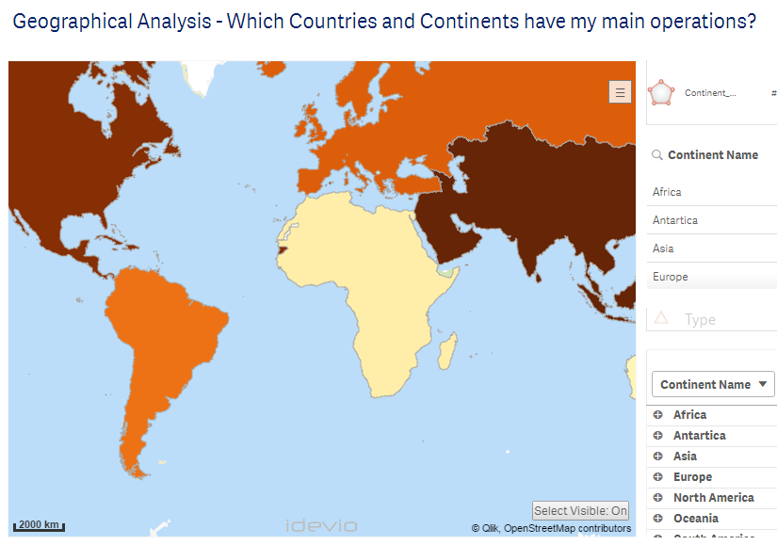
Dissolve - Use Cases
Creating your own custom area’s / polygons based on the aggregation of additional Polygons.
What do MY sales territories look like on a map?
I don’t have a polygon for the Continents, but I want to see my sales and operations by Continent.

Slide 36
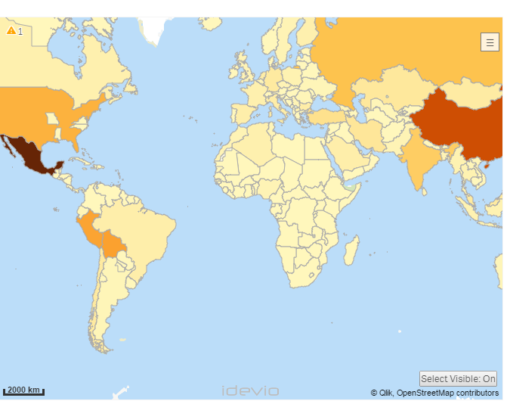
Dissolve – The Data
I have country information which I can plot using an area object, this can either be my own area files or using the Geometry Service area files. However I want to roll these up to a different level, for example in Continents and create a new area to show on the map.

Slide 37
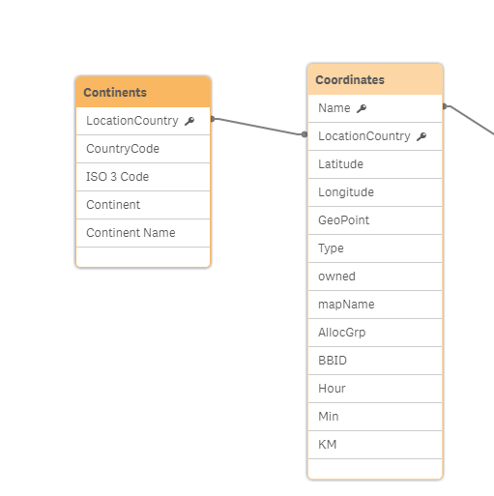
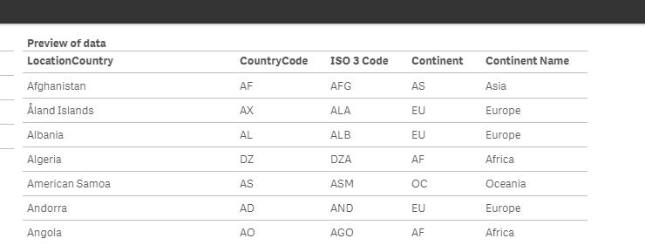
Dissolve – The data
I have loaded in a new table that maps my existing countries into the new grouping of continents ..

Slide 38
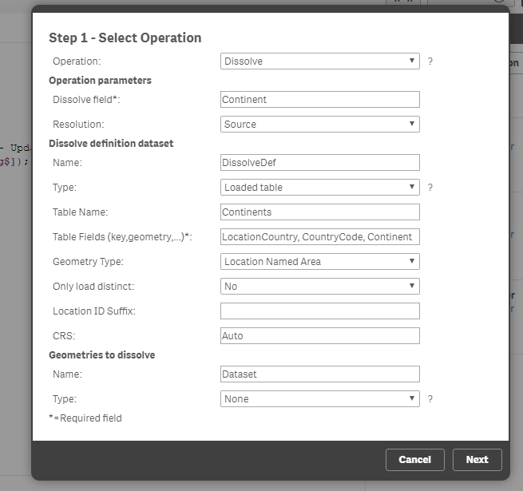
Dissolve – The Connector
Again, as I’m using a loaded table, I reference this loaded table ‘Continents’ and the relevant fields that I need LocationCountry which is my field, CountryCode and Continent. For this example I am using the CountryCode as a Location NamedArea from the Geometry Service as I know that Qlik GeoAnalytics has that data and I haven’t loaded it in as separate data.

Slide 39
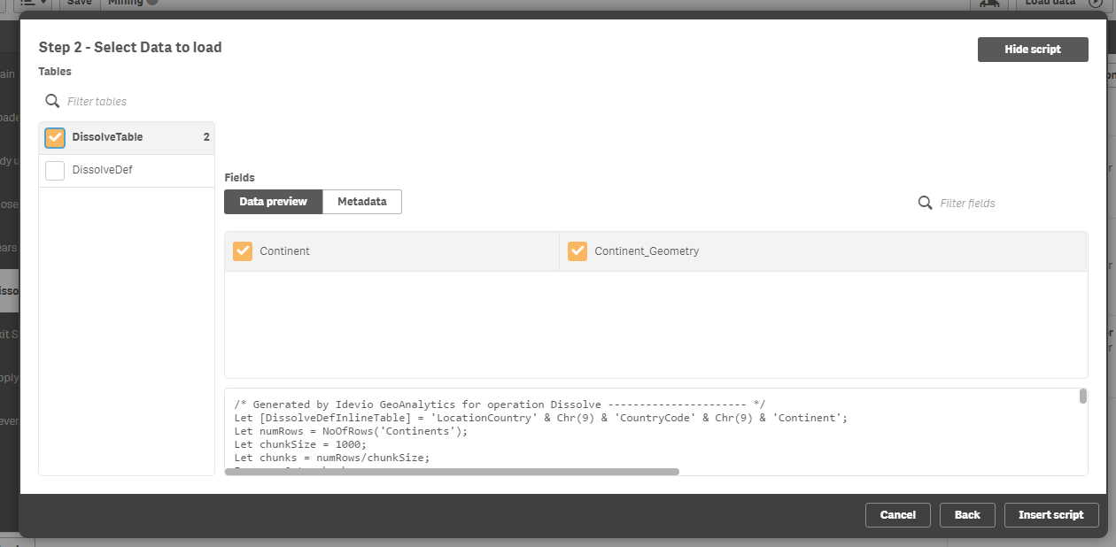
Dissolve – The Connector
I only need the first table as I already have the other data already loaded.

Slide 40
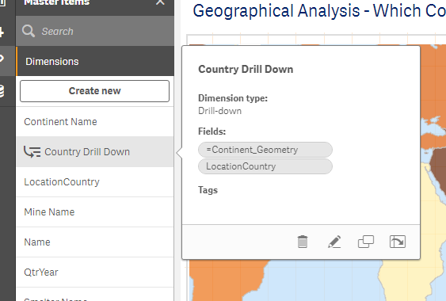
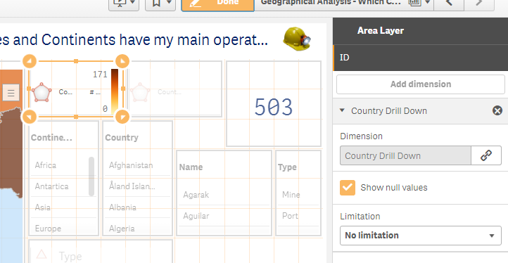
Dissolve – Displaying it on a map
I’ve created a drill down through the master items to allow me to move from Continent, down through to country and have used this as the dimension in my area object.

Slide 41
Qlik GeoAnalytics
Setting up the Operations
Travel Areas

Slide 42
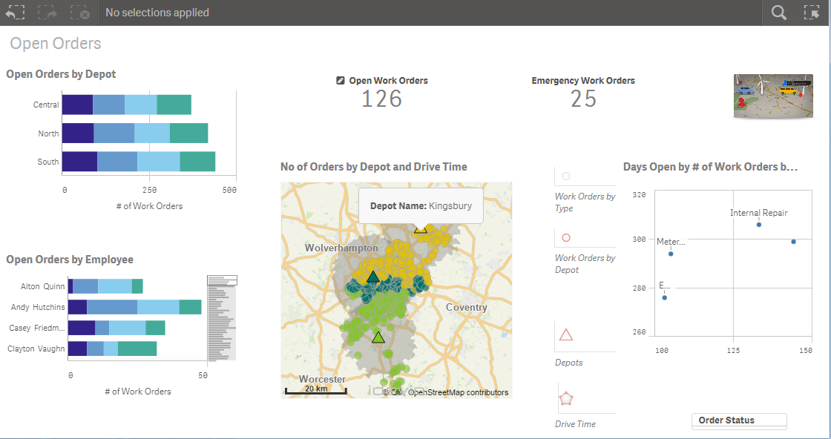
Travel Areas- Use Case
What is a 5, 10, 15 drive time from my store look like? How many people live in the location?
From my central depot, where can my engineers get to within a 10 minute drive time, using the road network?
Which Mast is affecting my customers based on a ½ mile coverage per mast?

Slide 43
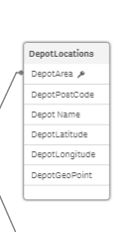
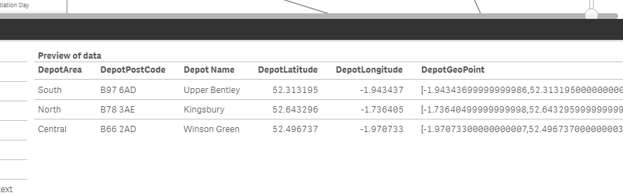
Travel Areas- The Data
I have a table loaded that has the Depot Areas and Locations .. With both latitude and longitude ..

Slide 44
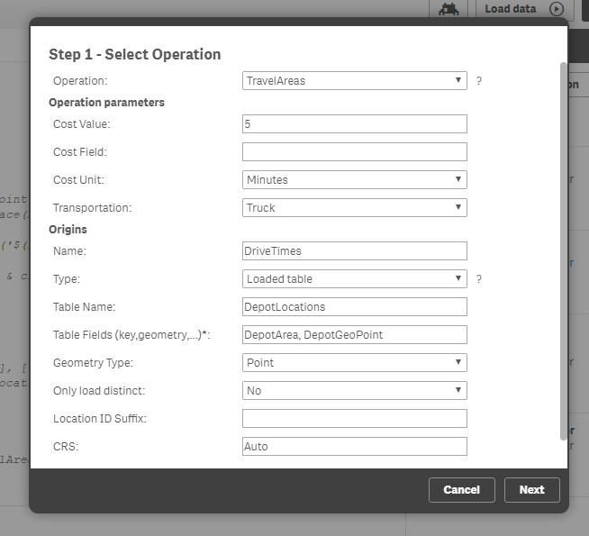
Travel Areas- The Connector
Choose to run the TravelAreas Operation, and use a 5 min truck journey, in my type, I use loaded table and then reference my locations table.
As I’m using the GeoPoint, I use the key field ‘DepotArea’ and the ‘DepotGeoPoint’. I set Point as the type.

Slide 45
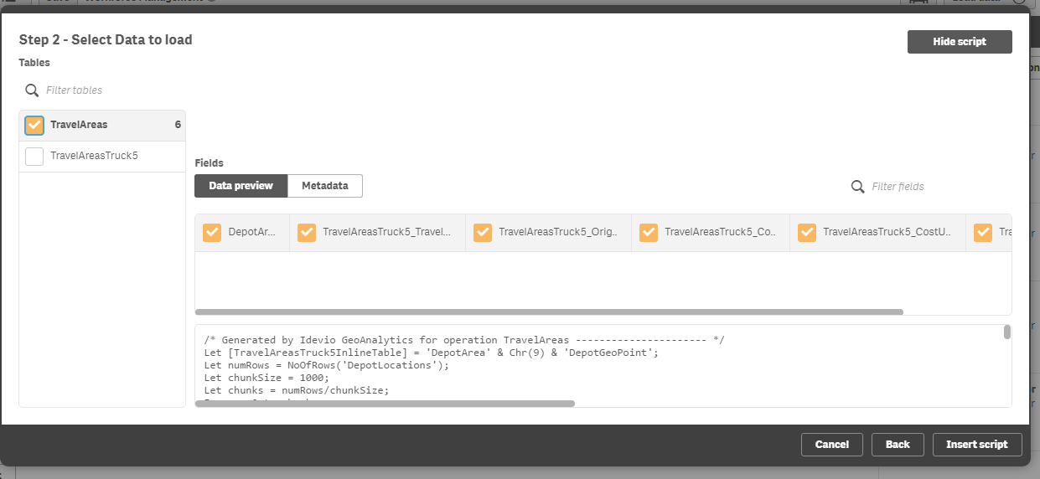
Travel Areas- The Connector
In this example I only need my new table ‘TravelAreas’

Slide 46
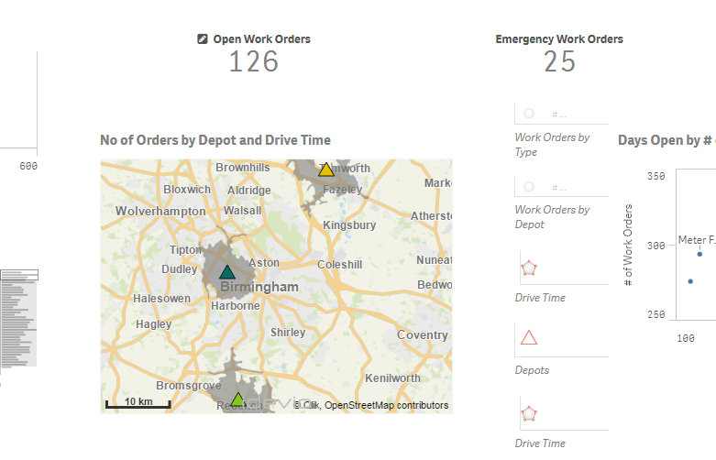
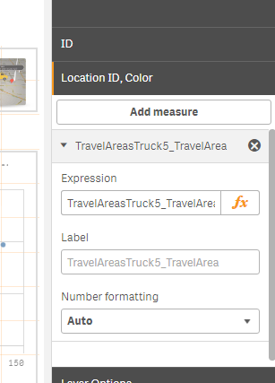
Travel Areas - Displaying them on a map
I can plot these on my map using a layer object of ‘Area’ and set the Depot Name as the Dimension, and the newly created ‘Travel AreaTruck5_Travel Area polygon.

Slide 47
Travel Areas- Displaying it on a Map
I can plot these on my map using a layer object of ‘Area’ and set the Depot Name as the Dimension, and the newly created ‘Travel AreaTruck5_Travel Area polygon.

Slide 48
Qlik GeoAnalytics
Setting up the Operations
Binning

Slide 49
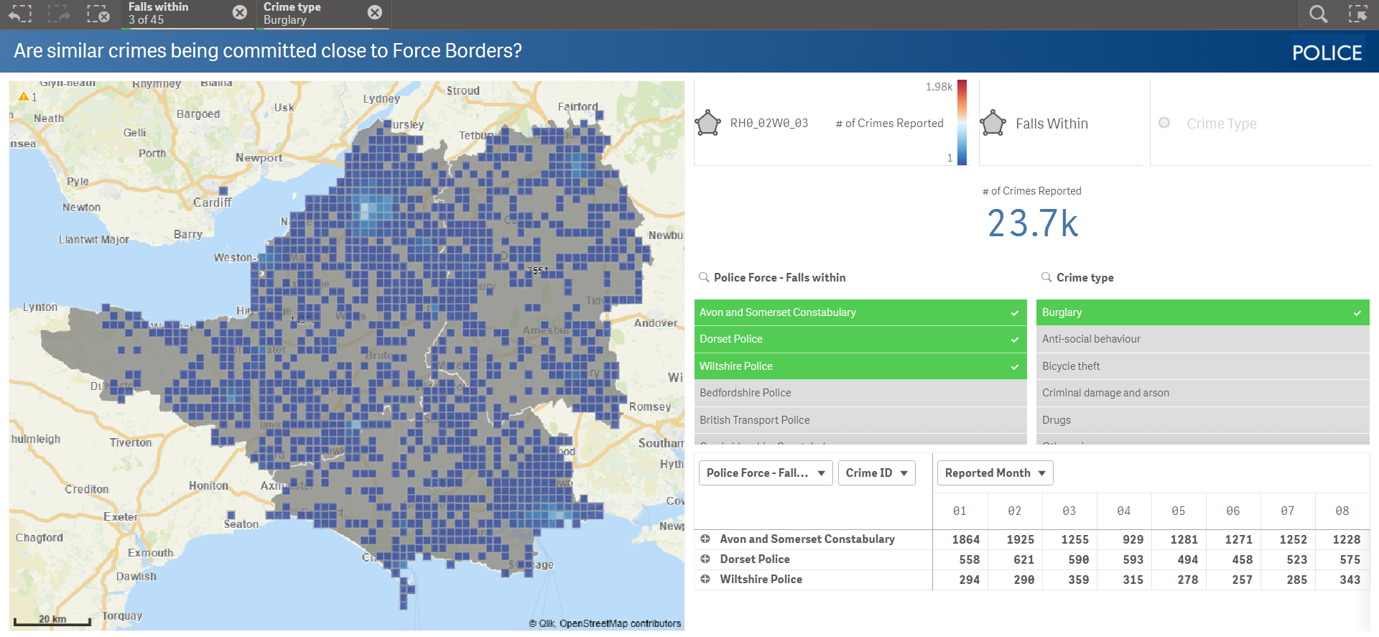
Binning - Use Case
Grouping together of different incidents (Crime’s, Incidents, Faults)
Allowing users to view Groupings and Aggregations across Boundaries.
Create a spatial histogram
Visualise density of an occurrence, i.e. outbreak of flu or Bovine TB.

Slide 50
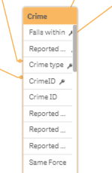
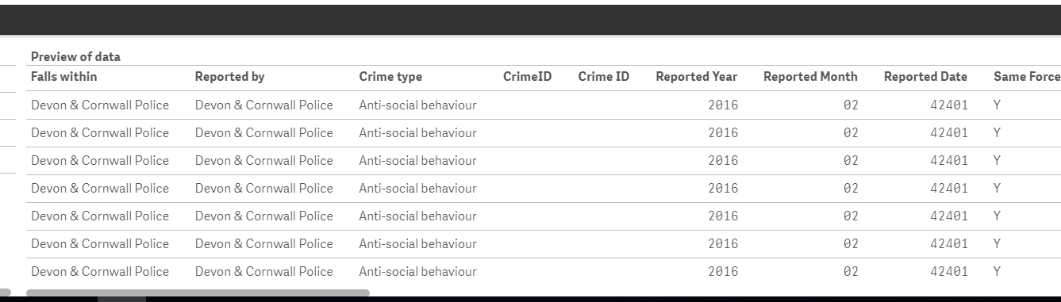
Binning - The Data
I have a table loaded that has crime locations .. With both latitude and longitude, by CrimeID ..

Slide 51
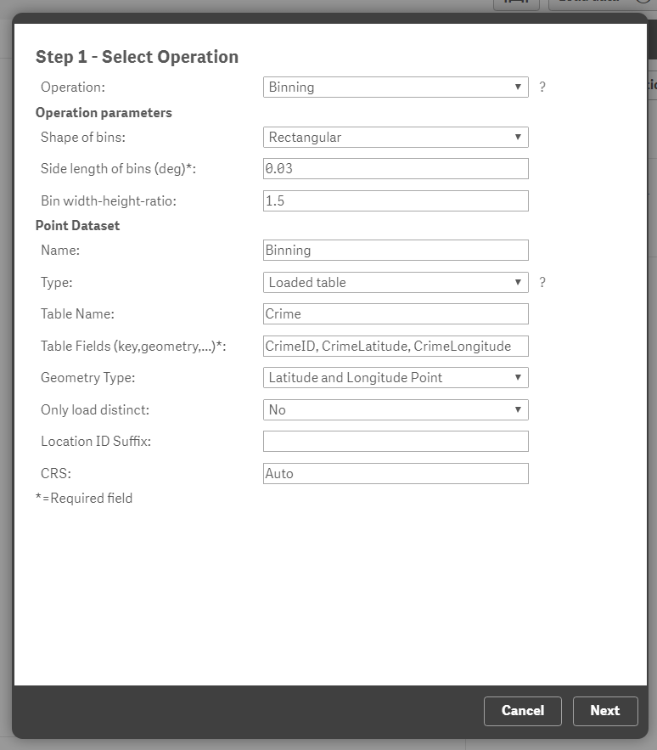
Binning - The Connector
I’m running the Binning Operation using a Rectangular shape, and a smallish bin side length (The size is specified in degrees, one degree is approximately 100000 m)
As I’m using the Latitude and Longitude, I use the key field ‘CrimeID’ and the ‘CrimeLatitude’ and ‘CrimeLongitude’. I set the type as Latitude and Longitude Points.

Slide 52


Binning - The Connector

Slide 53

Binning - The Connector
A new table is created which has the polygon (square) and an association to the CrimeID

Slide 54

Binning – Displaying on a Map
I use an Area Map object and reference my new field. For the colour and density I am using a sum(CrimeCounter).
Also, as there are a lot of Bins (the whole of the UK). I am using a condition so that they only display if I select multiple Police Force Borders (GetSelectedCount([Falls within])>=2 or GetSelectedCount([Falls within Area]) >=2 and GetSelectedCount([Crime type])=1) and a Crime Type – as I want to be able to see where Crime’s occur close to a border.

Slide 55

Binning – Displaying on a Map
This will allow me to see where Burglaries are being committed close to different Police Borders, potentially linked Geographically if not by Police Force.

Slide 56
Qlik GeoAnalytics
Setting up the Operations
Clusters

Slide 57

Clusters – Use Case
Clustering allows users to users to view the Geographic density of points or events.
Where are most burglaries being committed?
Where do most of my customers live, work.
Where are my main outbreaks of a disease?
Where are most of my faults being recorded?
Where are the main places my employees are working?

Slide 58


Clusters – The data
I have a table with Orders (Work Orders) within it, along with a GeoPoint for the location of the work.

Slide 59

Clusters – The Connector
I wish to cluster to 10,000 metres and am using a previously loaded table, WorkOrders.
Within this I have my key field of Order and my geographical element, ‘PostCodeGeoPoint’.
As this is a point, I use ‘Point’ as the Geometry Type.
NOTE: Check the volume of records as you may need to split it into smaller chunks.

Slide 60

Clusters – The Connector
As I already have the data loaded in as a table, I only need the first two tables, otherwise this will create a synthetic key.

Slide 61



Clusters – The Connector
I now have two new tables created, one for the clusters themselves, and one for the Cluster Associations, which has the association to my WorkOrders table.

Slide 62


Clusters – Plotting it on the map
Ideally I wish to be able to view the cluster and then drill down to the detail below. Therefore firstly, I create a new dimension for this, my Cluster Drill Down, which consists of my new field ‘Clusters_ClusterID’ and my detailed item, ‘Order’

Slide 63


Clusters – Plotting it on the map
I will add two Bubble Objects onto my map, one to show the Cluster, and the other for the drill down.
For the first, I will use the newly created field ‘Clusters_ClusterCentre’
With the location being a sum of the cluster points.

Slide 64


Clusters – Plotting it on the map
If it doesn’t appear straight away on the map, I may need to change the Location Source to Dimension.
I also want to Restrict the drill down to 0, so that once a selection has been made the cluster will disappear – this is under Layer Options.

Slide 65


Clusters – Plotting it on the map
For my second bubble layer, I want to use my newly created drill down.
And as a location use my location field, PostCodeGeoPoint.

Slide 66

Clusters – Plotting it on the map
As I want this to appear once I’ve clicked on my cluster, I choose the drill down level to be at 1.
NOTE: if once you have saved the settings, these don’t appear, you may need to refresh the application or close it down and re-open it

Slide 67


Clusters – Plotting it on the map
So I can now click on a cluster, and then will see all of the Orders below that make up that Cluster.

Slide 68
Qlik GeoAnalytics
Setting up the Operations
Load – Using a Shp file

Slide 69

Load – Use Case
Customers may wish to Load shape files from different systems, i.e. ArcGis or ESRI. These may be there own shapes or shapes that they have purchased.
Alternatively, they may be additional files that show different geographical backgrounds and points of interest.

Slide 70



Load – Shp file - The Data
Drag in the file to the layers panel to view and then check the code in the bottom of the screen to see what type of ..
In this case, there are four separate zip files that make up this complete shape. Each zip contains a shp file in it
You may first wish to check the shape file using a third party viewing tool.
As recommended, I’m using the QGIS tool which is freeware.

Slide 71

Load – The Connector
If it is a complicated shape file, you can do a Simplify first, or you can do a load and then Simplify the file, or just do a load .. In this case I am just doing a load.

Slide 72

Load – The Connector
Select the data that you want to bring in ..

Slide 73


Load – The Connector
Four new tables have been created
Each with the Geometry for the relevant shape file.

Slide 74


Load – Plotting it on the Map
As the shape files I have brought in are all Polygons except for one, I will use the Area Object. Referencing the new Polygon field that was created.
I will do the same thing for the other 2 Polygons and create a Bubble Layer for the shp file that contained the center point.

Slide 75

Load – Plotting it on the Map

Slide 76


Load – Plotting it on the Map
Of course, if I am using ArcGis online, I can use the GeoData Layer and a link to the WMS web service directly without having to load the shape file directly.

Slide 77
Qlik GeoAnalytics
Setting up the Operations
Within

Slide 78

Within – Use Case
Use a geographical element to associate to a previously unassociated geographical element.
Which school catchment area does an address fall within?
Which Crimes fall within my own shape file representations?
Which customers live on a Flood Plain?

Slide 79


Within – The Data
I have a shp file that I have loaded into the system, but I now want to use this to enable me to associate, Crime data (lat / long) to this new shape for selection purposes at the moment, there is no association, therefore I will create it using ‘Within’ which will check the lat / long’s to see if they reside within any of my polygons.

Slide 80

Within – The Connector
As again I am using Latitude and Longitude co-ordinates, for the Dataset I’m testing on, I reference my CrimeID, CrimeLatitude and CrimeLongitude with Type as Latitude and Longitude Point. However my Area Dataset to test on, is a Polgon shape and therefore I just need the key field and the Geometry fields

Slide 81

Within – The Connector
As I already have the data loaded, I only need to bring in the ‘Within Associations’ table as I already have the other day (the compared to and compared data)

Slide 82


Within – Representing it on a map
I already had my shp files set up as Area Objects
But now due to having run the Within operation, I have an association between those and the crimes themselves ..

Slide 83

Within – Representing it on a map
So when I select those Polygons, then I can see all the Crimes that have fallen within those Polygons, in this case across Police Force Borders.

Slide 84
Qlik GeoAnalytics
Setting up the Operations
Load – Using a dfx (Cad) file

Slide 85

Load – Use Case
Customers may wish to Load shape files from different systems, i.e. dxf which shows indoor shapes (for example mall layout, warehouse layout).
This will allow for non mapping data to be used.

Slide 86

Load – dxf file (Cad) - The Data
You may first wish to check the file first using a third party viewing tool.
I’m using LibreCad which is freeware
I have used layers to link into my dataset, however each set item also has a entity id, which could also have been used.

Slide 87

Load – The Connector
I select the Load Operation, and choose the File Based geo dataset. I also put the full file name to the dfx file (file:///C:\Users\jgo\Documents\2 - Qlik\DataFiles\Fuel Retail\PetrolStation3.dxf) Beginning with file:/// as it is held locally on my machine.
I then select Autocad DXF file

Slide 88

Load – The Connector
Select to bring in all the fields – you will not see any of the data yet as the operation has not run yet.

Slide 89

Load – The Connector
GeoAnalytics has created the code for me.
I have also brought in an additional table to map the layers from within the dxf file into my data model

Slide 90





Load – The Tables
I have two new tables - my mapping one and the one created from the dxf file

Slide 91

Load – Using it in a map
When you add in a map, make sure you select ‘Empty (undefined meters) as the base map from the properties panel to ensure that there is no display behind ..

Slide 92

Load – Using it in a map
I am using two area layers both with the same dimensions, the newly created PetrolStation_Geometry (this s the polygons and lines from the dxf file.
I’m using two as I wish to colour one whilst using the second one as a background.

Slide 93

Load – Using it in a map

Slide 94

Load – Using it in a map
For the first layer (the background map), I make sure that I use, one of the following:
make the non selectable, left click in view or don't include in autozoom, layer options.
And as the expression I ignore any selections that are made.

Slide 95

Load – Using it in a map
For the second layer (the items to be overlayed), I also do the following:
make the non selectable, left click in view or don't include in autozoom, layer options.
I use a normal expression, but set the colour:
if(Score='PASS', rgb(0,153,0), if(Score='FAIL', rgb(204,0,0), rgb(160,160,160)))

